Slide 1

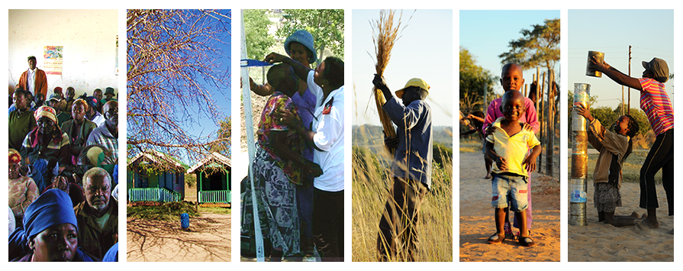
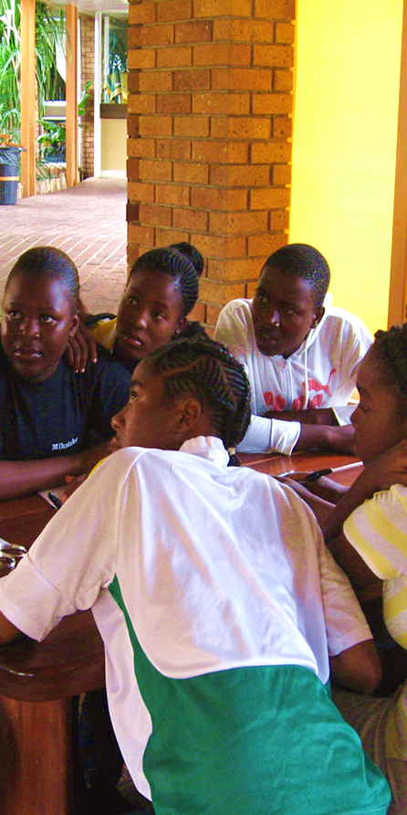

LM Albert
LM. Albert
LM. Albert
Practical Guide for Preparing
Health & Demographic Surveillance System Data for Analysis using Stata
by
Sulaimon A. Afolabi
Notes:
Hello everyone, my name is Sulaimon Afolabi. I am here to take you through a tutorial titled practical guide for preparing health & demographic surveillance system data for analysis using stata. By the way, stata is statistical software for data management and analysis.

Slide 2
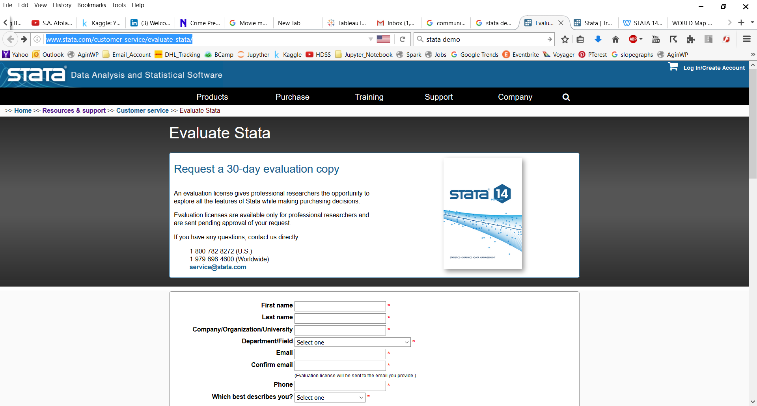
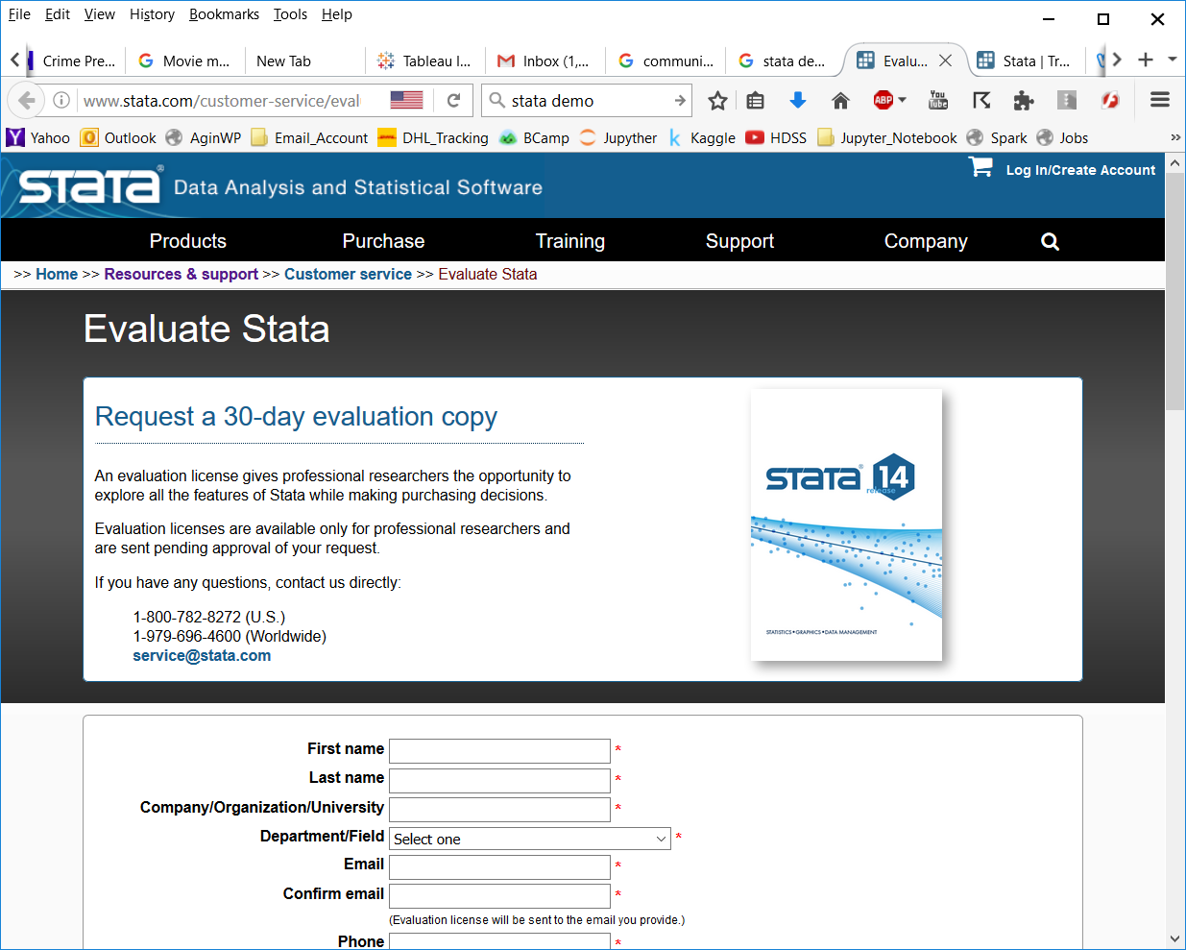
Notes:
You can visit stata website for a demo version of the software for practice at no cost.

Slide 3
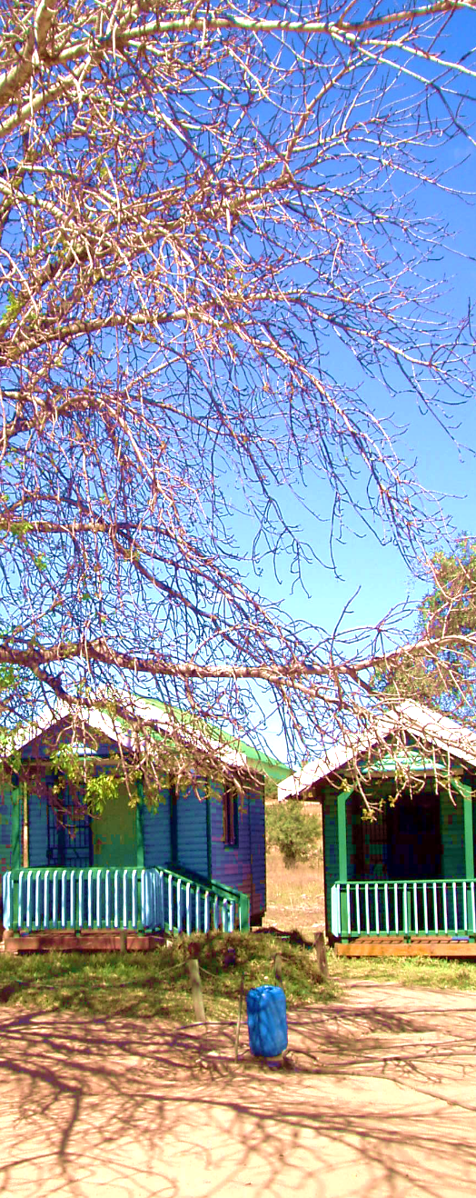
Learning Objectives
Have an understanding of health & demographic surveillance system;
Learn certain commands in stata;
Convert dataset from wide to long format;
Combine or merge two or more datasets;
Check dataset for inconsistencies;
Prepare dataset for event history and other analyses;
Perform event history analyses.

Slide 4

Health & Demographic Surveillance System
(HDSS)
HDSS
HDSS is a system established for the collection of health and demographic data on people living in a geographically delimited area.
Most HDSS sites operate a reference data model, which is a database design with the capacity to store temporal and relational information.
HDSS site can be found mostly in sub-Saharan Africa, Asia and other developing countries.
Notes:
I am going start this tutorial by giving an overview on HDSS. The acronym HDSS stands of health & demographic surveillance system.
HDSS is HDSS is a system established for the collection of health and demographic data on people living in a geographically delimited area.
Most HDSS sites operate a reference data model, which is a database design with the capacity to store temporal and relational information.
HDSS site can be found mostly in sub-Saharan Africa, Asia and other developing countries.

Slide 5
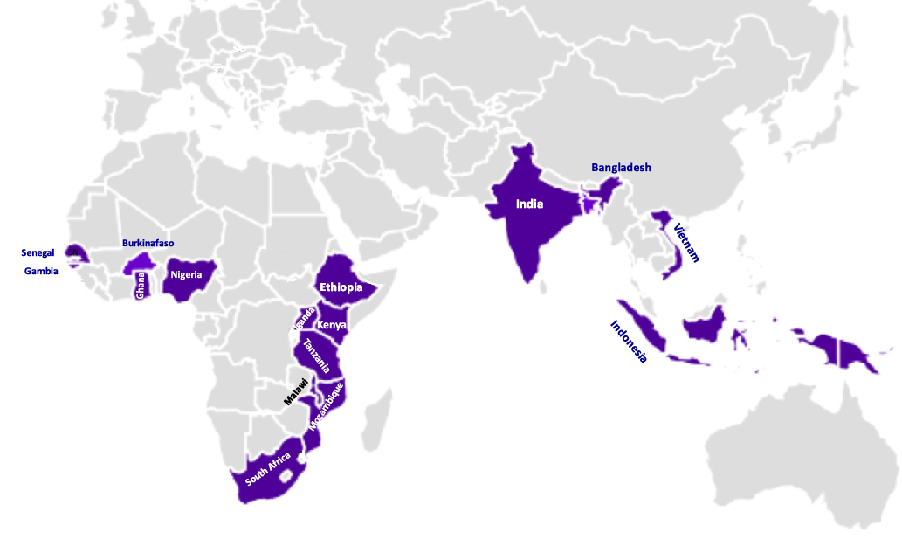
Countries with HDSS Sites

Slide 6
HDSS
Health & Demographic Surveillance System
(HDSS)
HDSS is a system established for the collection of health and demographic data on people living in a geographically delimited area.
Most HDSS sites operate a reference data model, which is a database design with the capacity to store temporal and relational information.
HDSS site can be found mostly in sub-Saharan Africa, Asia and other developing countries.
International Network of field sites with continuous Demographic Evaluation of Populations and Their Health also known as INDEPTH-Network, is an umbrella body of the HDSS sites.
Notes:
I am going start this tutorial by giving an overview on HDSS. The acronym HDSS stands of health & demographic surveillance system.
HDSS is HDSS is a system established for the collection of health and demographic data on people living in a geographically delimited area.
Most HDSS sites operate a reference data model, which is a database design with the capacity to store temporal and relational information.
HDSS site can be found mostly in sub-Saharan Africa, Asia and other developing countries.

Slide 7
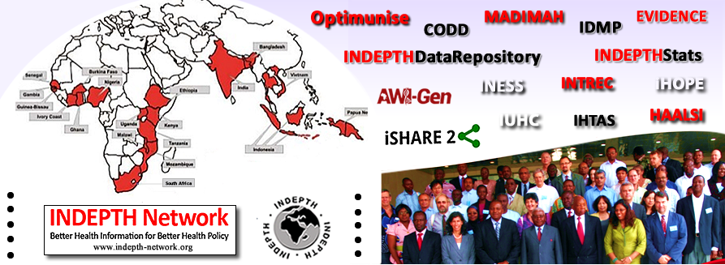
www.indepth-network.org

Slide 8
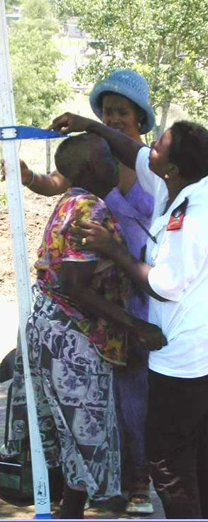
Data Structure
Object
Individuals
Birth
Death
In-migration
Out-migration
Event
Episode
Residence
Observation
Labour Status

Slide 9
HDSS Residence Episode
Entry
Birth
In-migration
Enumeration
Population under surveillance
Current
Death
Out-migration
Exit

Slide 10
Date 1 – Date 4
e
D
Date 2 – Current Date
Residents
B
point in time
Date 1 – Date 3
e
M
Date 2 – Date 4
M
M
D
Date 1 – Current Date
e
Timeline
Date 1
Date 2
Date 3
Date 4
Current
Date
e
Baseline Enumeration
B
Birth
In-Migration
C
Current
M
M
Out-Migration
Death
D

Slide 11
Wide Format
Id | Sex | Date of Birth | Start Date | End Date | Initiating-Event-Type | Terminating-Event-Type
FMCPT | Male | 1977-09-22 | 2001-07-15 | 2005-01-01 | In-Migration | Death
Long Format
Id | Sex | Birth Date | Event Date | Event Type
FMCPT | Male | 1977-09-22 | 2001-07-15 | In-Migration
FMCPT | Male | 1977-09-22 | 2005-01-01 | Death
Split Format
Id | Sex | Birth Date | Event Date | EventType
FMCPT | Male | 1977-09-22 | 2001-01-01 | In-Migration
FMCPT | Male | 1977-09-22 | 2002-01-01 | Resident
FMCPT | Male | 1977-09-22 | 2003-01-01 | Resident
FMCPT | Male | 1977-09-22 | 2004-01-01 | Resident
FMCPT | Male | 1977-09-22 | 2005-01-01 | Death

Slide 12

Building Codes
Clear all open records
Set memory size
Create a working directory
Load the dataset
Get summary info on dataset
Label the variables of interest
Recode relevant variables

Slide 13
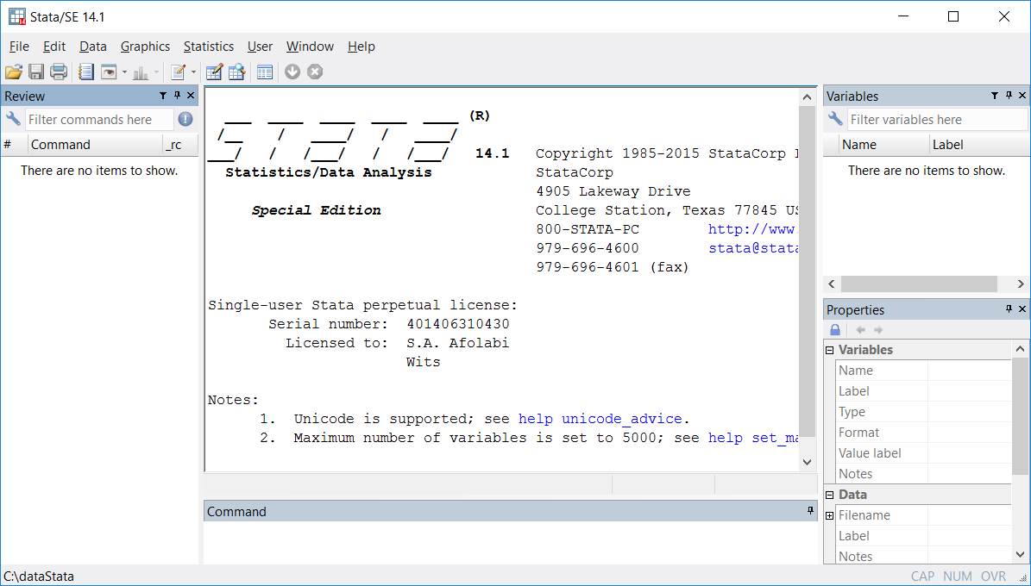
Backend
Do File button
Variable Pane
Review Pane
Variable
Properties Pane
Command Pane

Slide 14
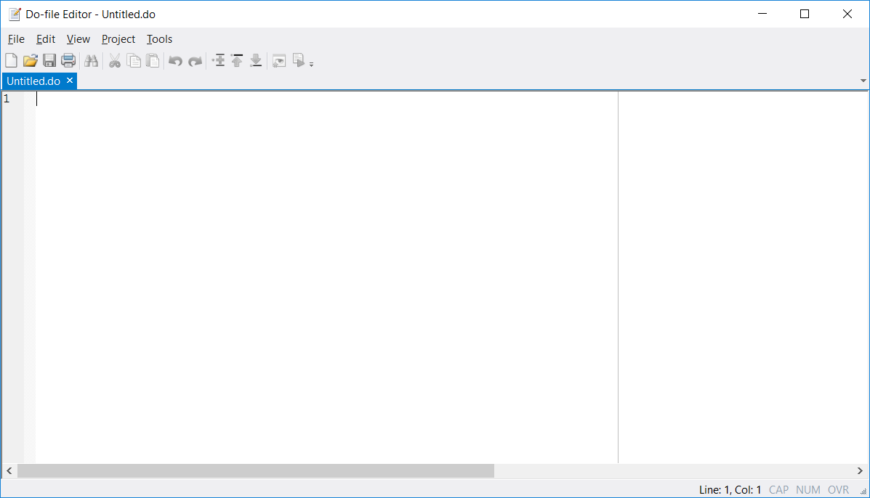
Run Button

Slide 15










Slide 16
https://github.com/afolaborn/Stata_Projects/tree/master/HDSS_Analysis
Stata DO Files
Data Files
Power point presentation

Slide 17
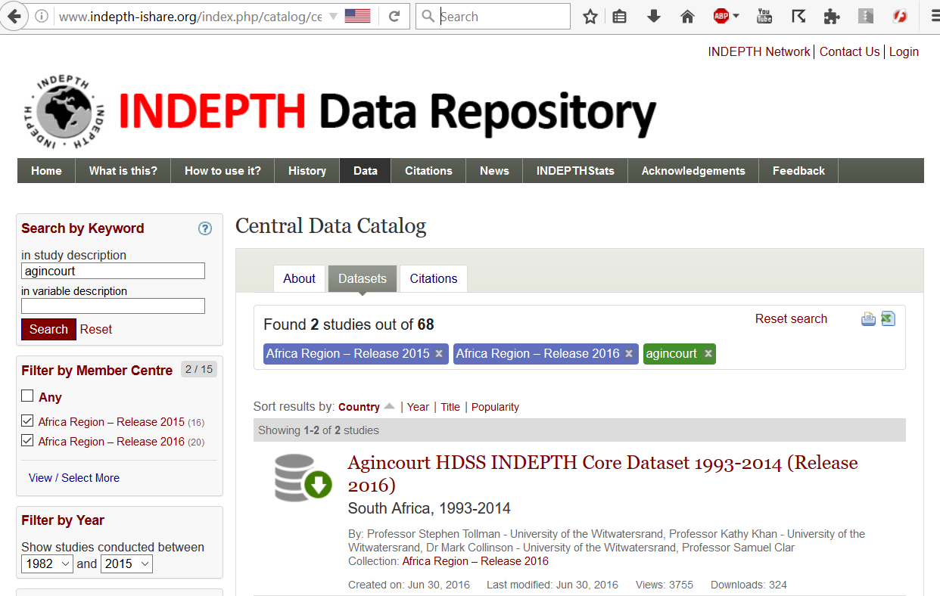

Slide 18
https://www.youtube.com/playlist?list=PLv5mj-2DreFjCDzG7zK5UJ3HmlwiIJ5dI
Click on the link below to watch the video on youtube

